Slide 1

Fiscal Patriots
Dashboard
George Mason University Costello College of Business
AGA Datathon 2026
Following the Money
Mapping Risk in Federal Spending
By: Khaled Alkurd, Nikita Chandrasing, Mariam Debas, Pranavi Doodala, Andy Yaro

Slide 2
Where does Federal Funding go, and can we trust who receives it?
The Data
The Problem
The Solution
We Connected the Dots
74M USAspending records processed
57,448 audited entities analyzed
3 federal systems integrated
Trust Can't Be Verified
72% of exclusions lack a UEI in SAM.gov dataset
Audit Failures don't reduce funding
5.05T to high-risk entities
We Built the Tools
42,233 entities matches & scored
Taxpayer Protection Score (0-100)
Predictive risk model
Citizens can finally see where tax dollars go
But they can't verify which entities to trust
Until now

Slide 3
Our Data Foundation
USAspending.gov
Federal Audit ClearingHouse
SAM.gov
Federal awards, grants, and contracts
74M records FY2019-2024
Single audit findings and compliance
57,448 entities FY2016-Present
Excluded & debarred entities
Governmentwide exclusions
167,000 records
All active
Connected by UEI Unique Entity Identifier

Slide 4
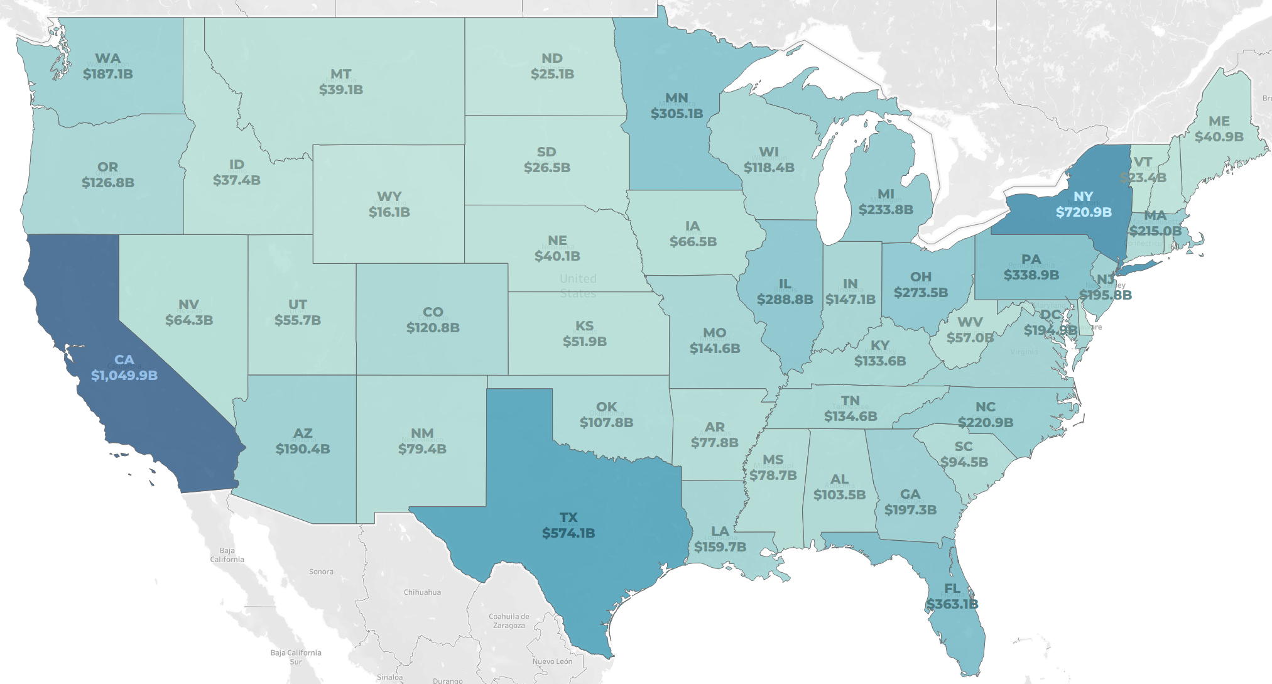
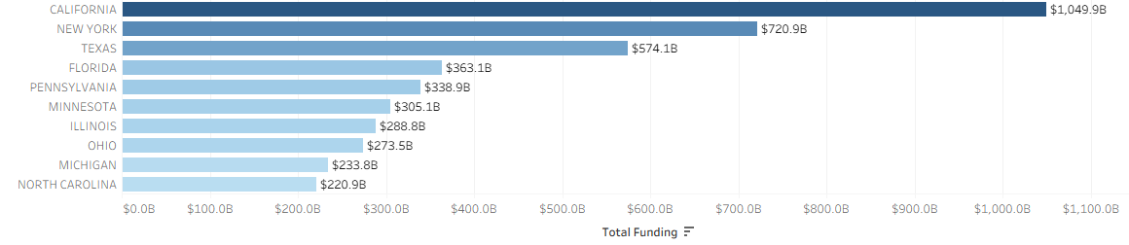
Where Does Federal Funding Go?
Funding Snapshot
$8.58 Trillion Total Federal Funding (FY2019-2024)
51% Goes to Top 10 States
12% California Alone ($1.05 Trillion)
California consistently receives the most federal funding

Slide 5
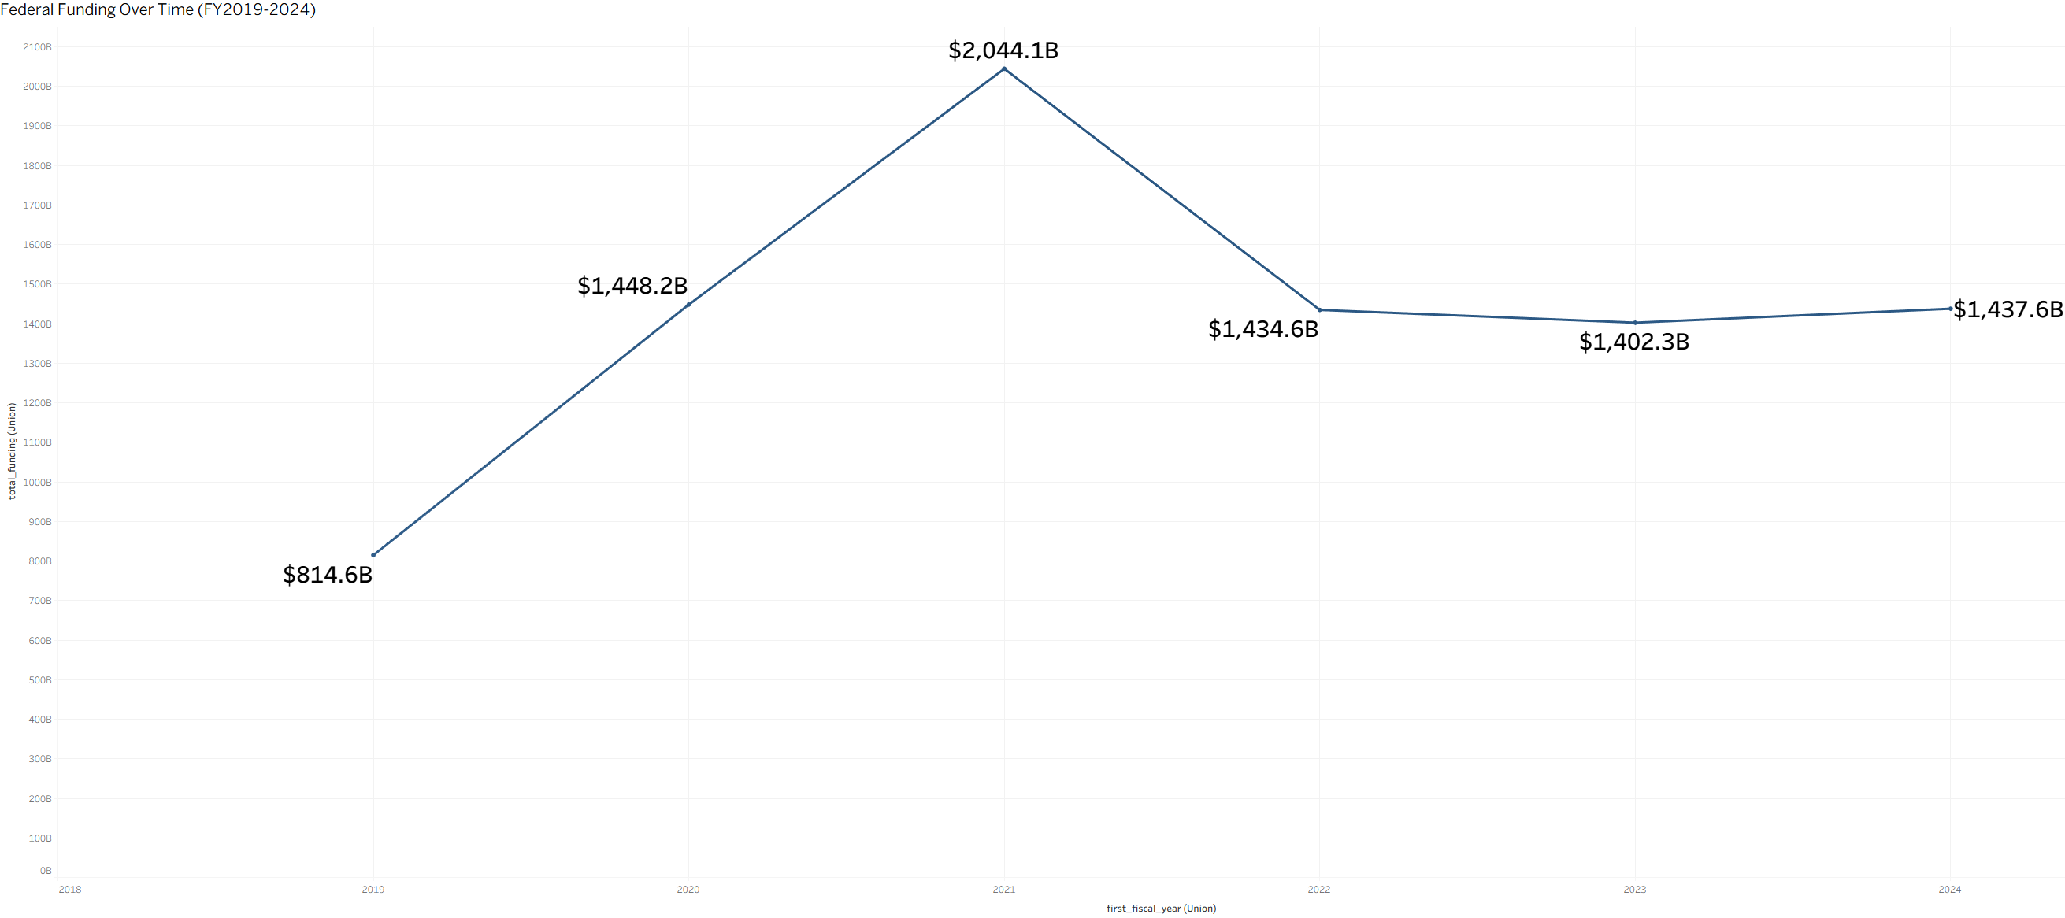
Federal Funding Over Time (FY2019-2024)
Trend Snapshot
$2.04 Trillion FY2021 Peak (COVID)
$1.4 Trillion Stabilized by FY2022
3 Years Flat FY2022-2024
2019
2020
2021
2022
2023
2024
Annual funding was driven to record highs due to COVID but has since stabilized at $1.4T

Slide 6
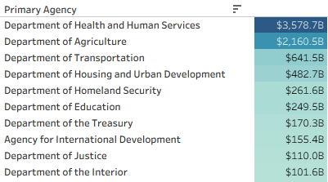
How is Funding Concentrated?
8% 33 Other Agencies
($670B)
Top 10 Agencies by Federal Funding (FY2019-2024)
Concentration Snapshot
$3.58 Trillion to HHS Alone (42%)
67% Top 2 Agencies (HHS + Agriculture)
92% Top 10 Agencies
33 other agencies share just 8%
92% Top 10 Agencies ($7.9T)
10 of 43 Agencies
Account for 92% of Funding
HHS and USDA fund what Americans rely on most, healthcare and nutrition assistance. Where funding concentrates, so should scrutiny

Slide 7
Promoting Financial Transparency
Objectives
Solution
Outcomes
Allow citizens to clearly see the programs and entities their money is funding.
Highlight at risk funding and recipients
…
[Insert main components of solution]
[Insert main components of solution]
…
[Insert project time frame]
[Insert main outcomes of project e.g. a clear recommendation to x]
[Insert main outcomes of project]
…

